Slide 1
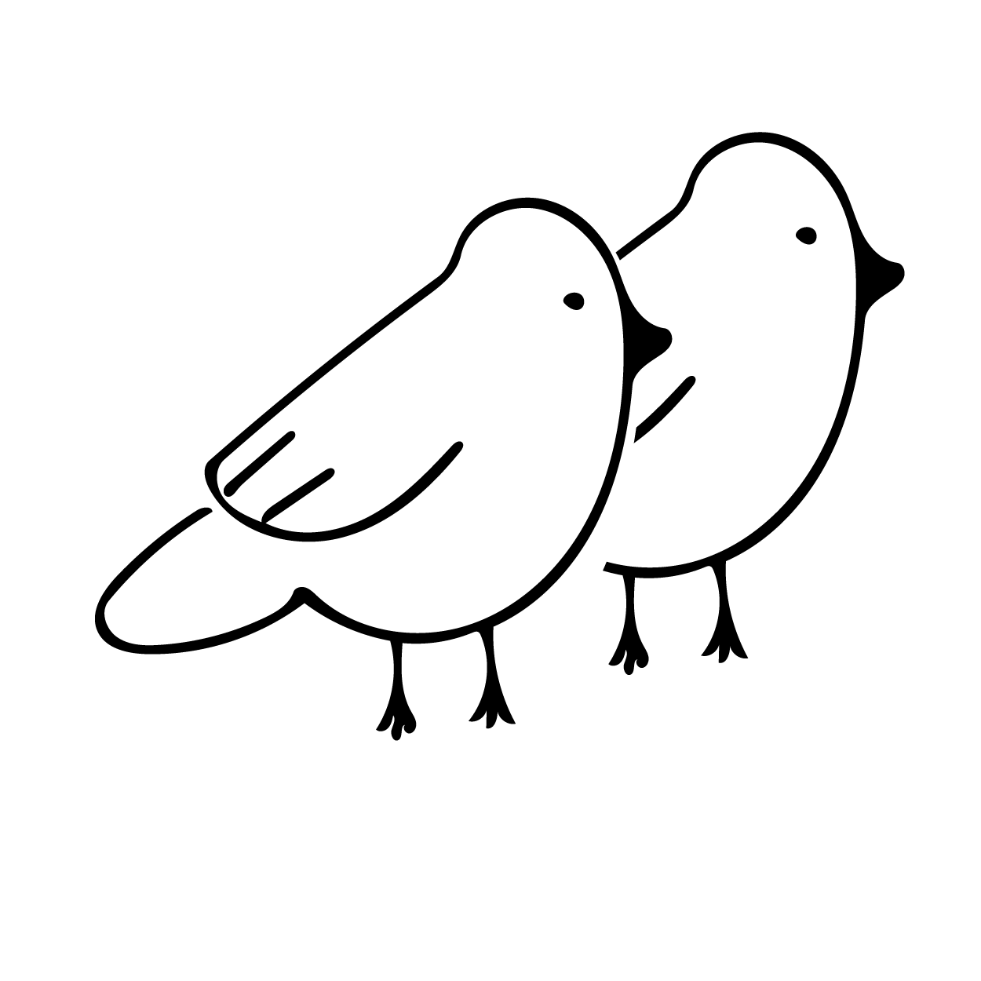
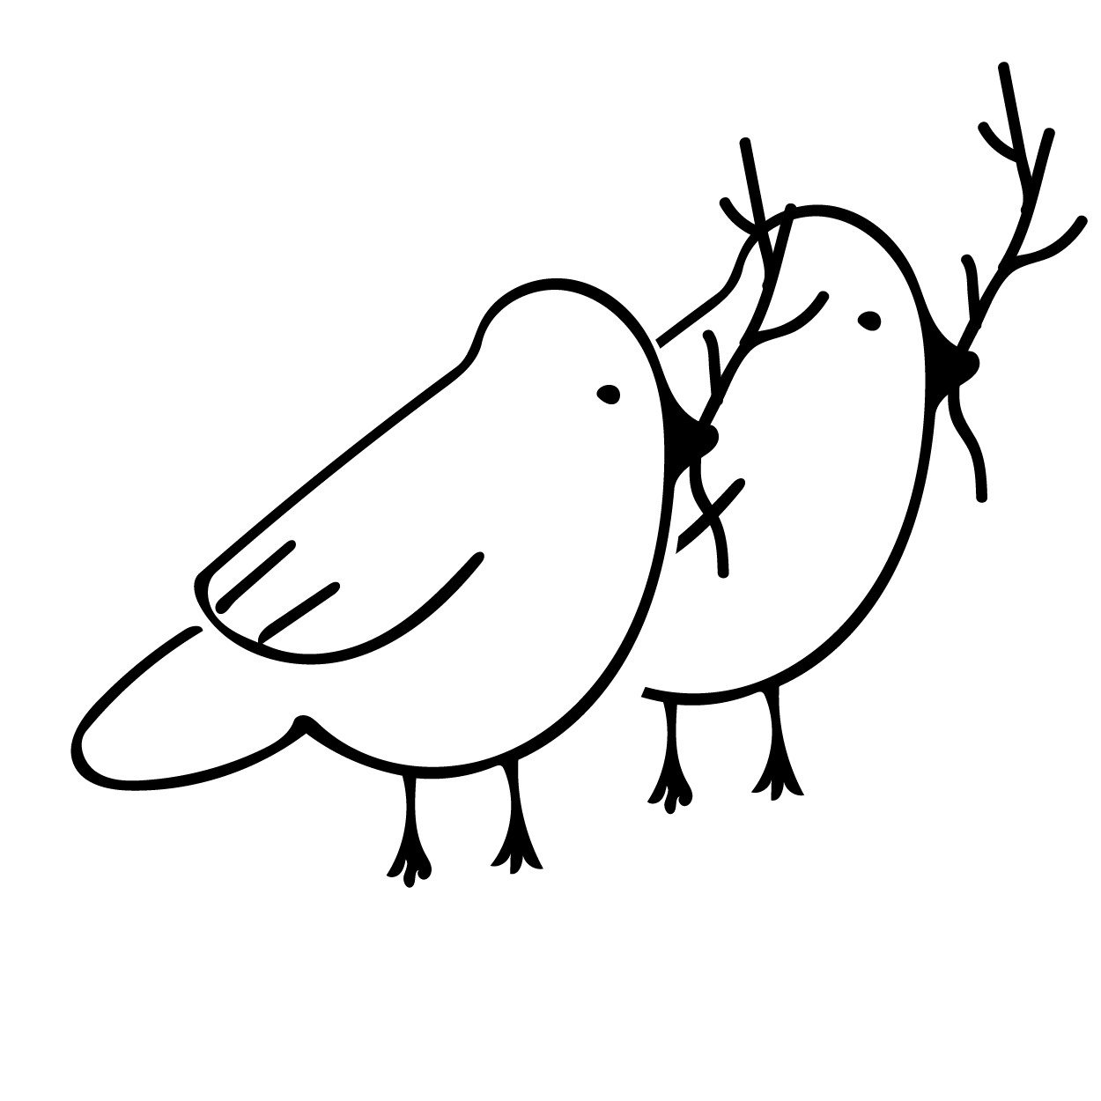

Subject, Verb, and Direct Object
Subject: Who or what is acting in the sentence?
Birds
Verb: What are the birds doing?
Birds build
Direct object: What do the birds build?
Birds build nests
SUBJECT
VERB
DIRECT OBJECT
Birds + build + nests

Slide 2
Independent and Dependent clauses
An independent clause can stand on its own:
SUBJECT
VERB
DIRECT OBJECT
Birds + build + nests
Adding a marker word such as “because” makes this a dependent clause. It’s not complete anymore:
DIRECT OBJECT
birds + build + nests
VERB
SUBJECT
MARKER WORD
because
Add an independent clause to make its meaning complete:
DEPENDENT CLAUSE
INDEPENDENT CLAUSE
MARKER WORD
SUBJECT
VERB
DIRECT OBJECT
SUBJECT
VERB
DIRECT OBJECT
because
+
birds + build + nests
they + need + twigs
+
A dependent clause + an independent clause is a complete sentence!
Notes:
NOTE! Firefox and Chrome handle the alignment differently!

Slide 3




Subject Verb Agreement
?
Which verb should you use? Many waiters ______ orders.
SINGULAR VERB
PLURAL NOUN
takes
waiters
PLURAL VERB
Careful! Plural verbs do NOT end in -s.
take
A plural noun takes a plural verb: Many waiters take orders.
PLURAL NOUN
PLURAL VERB
waiters
take

Slide 4
Subject Verb Agreement
?
Which verb should you use? They ______ orders.
SINGULAR VERB
PLURAL PRONOUN
takes
they
Careful! They is a plural pronoun, even though it does not end in -s!
PLURAL VERB
take
A plural pronoun takes a plural verb: They take orders.
PLURAL NOUN
PLURAL VERB
they
take

Slide 5

Subject Verb Agreement
?
Which verb should you use? A waiter ______ orders.
SINGULAR VERB
takes
SINGULAR NOUN
Careful! Singular verbs DO end in an -s!
waiter
PLURAL VERB
take
A singular noun takes a singular verb: A waiter takes orders.
SINGULAR NOUN
SINGULAR VERB
waiter
takes

Slide 6
Subject Verb Agreement
?
Which verb should you use? He ______ orders.
SINGULAR VERB
takes
SINGULAR PRONOUN
he
PLURAL VERB
take
A singular pronoun takes a singular verb: He takes orders.
SINGULAR PRONOUN
SINGULAR VERB
he
takes

Slide 7
Subject Verb Agreement
?
Which verb should you use? A tiger ______ quickly.
SINGULAR VERB
runs
SINGULAR NOUN
Careful! Singular verbs DO end in an -s!
tiger
PLURAL VERB
run
A singular noun takes a singular verb: A tiger runs quickly.
SINGULAR NOUN
SINGULAR VERB
tiger
runs

Slide 8
Subject Verb Agreement
?
Which verb should you use? It ______ quickly.
SINGULAR VERB
runs
SINGULAR PRONOUN
it
PLURAL VERB
run
A singular pronoun takes a singular verb: It runs quickly.
SINGULAR PRONOUN
SINGULAR VERB
it
runs

Slide 9
Subject Verb Agreement
?
Which verb should you use? Many tigers ______ quickly.
SINGULAR VERB
PLURAL NOUN
runs
tigers
PLURAL VERB
Careful! Plural verbs do NOT end in -s.
run
A plural noun takes a plural verb: Many tigers run quickly.
PLURAL NOUN
PLURAL VERB
tigers
run

Slide 10
Subject Verb Agreement
?
Which verb should you use? They ______ quickly.
SINGULAR VERB
PLURAL PRONOUN
runs
they
Careful! They is a plural pronoun, even though it does not end in -s!
PLURAL VERB
run
A plural pronoun takes a plural verb: They run quickly.
PLURAL PRONOUN
PLURAL VERB
they
run

Slide 11
Subject Verb Agreement
Scratch slides, not used.
Match the noun to its correct verb:
SINGULAR VERB
takes
SINGULAR NOUN
Waiter
PLURAL VERB
take
SINGULAR NOUN
SINGULAR VERB
A singular noun takes a singular verb.
Waiter
takes
Notes:
Not used

Slide 12
Subject Verb Agreement
Scratch slides, not used.
Match the noun to its correct verb:
Singular Verb
takes
Plural Noun
Waiters
Plural Verb
take
Plural Noun
Plural Verb
Waiters
take
A plural noun takes a plural verb.
Notes:
Not used

Slide 13
Subject Verb Agreement
Scratch slides, not used.
Match the noun to its correct verb:
Singular Verb
Singular Noun
takes
Waiter
Plural Verb
take
Singular Noun
Singular Verb
Waiter
takes
A singular noun takes a singular verb.
Notes:
Not used

